Slide 1


Analysis top 5 content categories

Slide 2


Today's agenda
Project recap
Problem
The Analytics team
Process
Insights
Summary

Slide 3


Social Buzz is a fast growing technology unicorn that need to adapt quickly to it's global scale. Accenture has begun a 3 month POC focusing on these tasks:
• An audit of Social Buzz's big data practice
Recommendations for a successful IPO
Analysis to find Social Buzz's top 5 most popular categories of content
Project Recap

Slide 4


Problem
Over 10k post per days
36.5M pieces of content per year !
But how to capitalize on it when there is so much ?
Analysis to find Social Buzz’s top 5 most popular categories of content

Slide 5
Andrew Fleming (Chief Technical Architect)
The Analytics team
Marcus Rompton (Senior Principle)
Aashirwad Mehare (Data Analyst)

Slide 6

Process
1
Data Understanding
2
Data Cleaning
Data Modelling
3
4
Data Analysis
5
Uncove Insights

Slide 7


Insights
1879
Most Reacted Post “Animal”
“Jan”
Most Post
In Month
16
Category

Slide 8
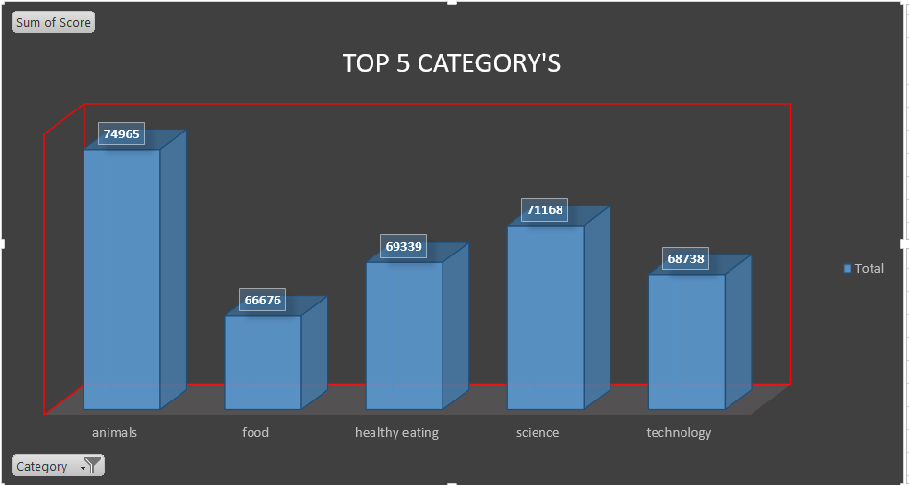
Top 5 category by “Population”score

Slide 9
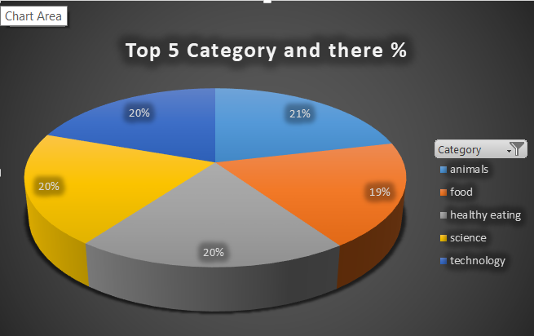

Slide 10
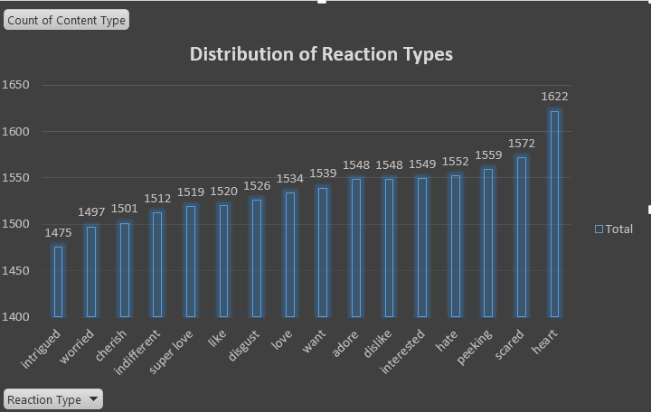

Slide 11
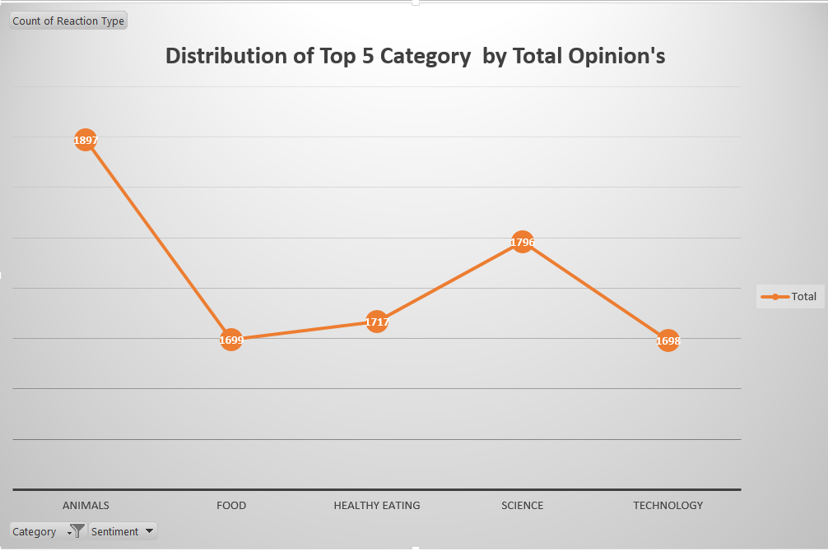

Slide 12
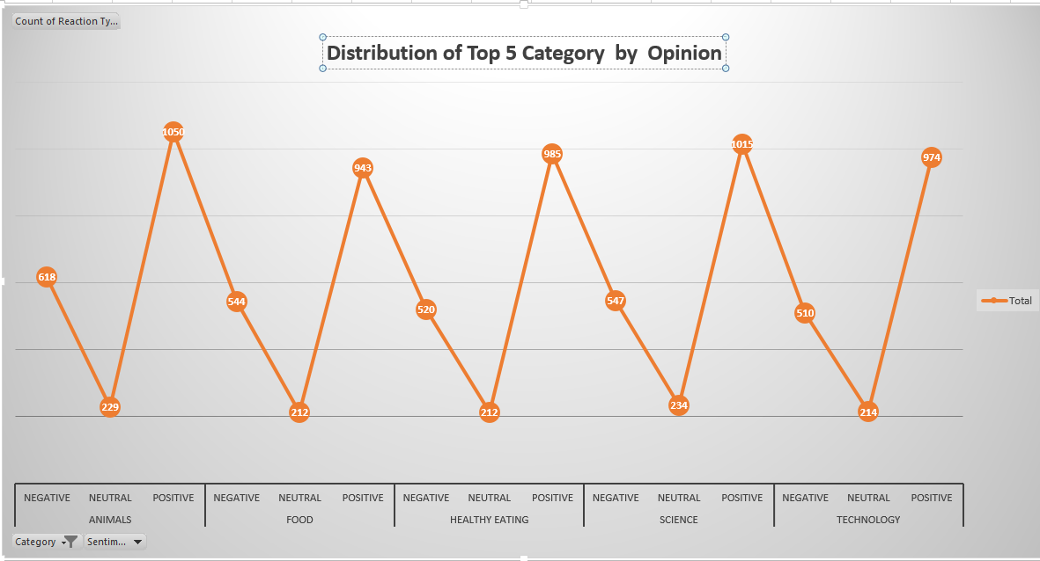

Slide 13


This analysis shows that people like to see real-life and factual content, especially about animals and science. Food is also popular, with healthy eating being the most popular topic. This suggests that you could create campaigns about healthy eating and work with relevant brands to attract more users. To get a better understanding of your business in real-time, you can use large-scale analysis.
Summary

Slide 14

Thank you!
ANY QUESTIONS?

